Slide 1
AI-Systems Distributed Training
Joseph E. Gonzalez
Co-director of the RISE Lab jegonzal@cs.berkeley.edu

Slide 2
What is? & Why? Distributed Training
Distributed Training* ~ Training across multiple devices
Different local and remote memory speeds / network
Why do we need distributed training?
Faster training by leveraging parallel computation
Additional memory (memory bandwidth) for larger model
“Need” to store weights + activations
Reduce or eliminate data movement
Privacy → Federated Learning
Limited bandwidth to edge devices
Need to process all the data?
*Very simplified definition.

Slide 3
On Dataset Size and Learning
Data is a a resource! (e.g., like processors and memory)
Is having lots of processors a problem?
You don’t have to use all the data!
Though using more data can often help
More data often* dominates models and algorithms
*More data also supports more sophisticated models and algorithms.

Slide 4
What are the Metrics of Success?
Marketing Team: Maximize number of GPUs/CPUs used
A bad metric … why?
Machine Learning: Minimize passes through the training data
Easy to measure, but not complete … why?
Systems: minimize time to complete a pass through the training data
Easy to measure, but not complete … why?

Slide 5
Ideal Metric of Success
“Learning”
Second
“Learning” Record
Record
Second
=
x
Convergence
Machine Learning
Property
Throughput
System
Property

Slide 6
Metrics of Success
Minimize training time to “best model”
Best model measured in terms of test error
Other Concerns?
Complexity: Does the approach introduce additional training complexity (e.g., hyper-parameters)
Stability: How consistently does the system train the model?
Cost: Will obtaining a faster solution cost more money (power)?

Slide 7
Map-Reduce for Distributed Training
The Early Days….
Learning by Distributed Aggregation

Slide 8

Learning from Statistics (Aggregation)*
Learning Algorithm
Query:
System
Data
D. Caragea et al., A Framework for Learning from Distributed Data Using Sufficient Statistics and Its Application to Learning Decision Trees. Int. J. Hybrid Intell. Syst. 2004
Chu et al., Map-Reduce for Machine Learning on Multicore. NIPS’06.
*next set of slides are old!
Notes:
Chu and several others (including me) have incorrectly attributed this pattern to the statistical query model of M. Kearns, STOC’93.

Slide 9
Can we compute
using the statistical query pattern in map-reduce?
Query:
Algorithm
Response:

Slide 10
Can we compute
using the statistical query pattern in map-reduce?
Query 1
Query 2
Query:
Algorithm
Break computation into two queries
Response:

Slide 11
Cost Analysis
Comutation
Cost
When n >> p we want to distribute this computation

Slide 12
Logistic Regression using Gradient Descent?
What about

Slide 13
Logistic Regression in Map-Reduce
Gradient descent:
Learning Algorithm
Query:
System
Data
Update Model:

Slide 14
Logistic Regression in Map-Reduce
Map-Reduce is not optimized for iteration and multi-stage
computation
Gradient descent:
Learning Algorithm
Query:
System
Data
Update Model:

Slide 15
Iteration in Map-Reduce
Initial
Model
Learned
Model
Map
Reduce
w⁽⁰⁾
w⁽¹⁾
Training
Data
w⁽²⁾
w⁽³⁾

Slide 16
Cost of Iteration in Map-Reduce
Initial
Model
Learned
Model
Map
Reduce
w⁽⁰⁾
w⁽¹⁾
Read 1
Training
Data
Repeatedly load same data
Read 2
w⁽²⁾
Read 3
w⁽³⁾

Slide 17
Cost of Iteration in Map-Reduce
Initial
Model
Learned
Model
Map
Reduce
w⁽⁰⁾
w⁽¹⁾
Training
Data
Redundantly save output between stages
w⁽²⁾
w⁽³⁾

Slide 18

Iteration and Multi-stage computation
In-Memory
Dataflow
System
M. Zaharia, M. Chowdhury, M. J. Franklin, S. Shenker, and I. Stoica. Spark: cluster computing with working sets. HotCloud’10
M. Zaharia, M. Chowdhury, T. Das, A. Dave, J. Ma, M. McCauley, M.J. Franklin, S. Shenker, I. Stoica. Resilient Distributed Datasets: A Fault-Tolerant Abstraction for In-Memory Cluster Computing, NSDI 2012

Slide 19
Dataflow View
Map
Reduce
Training Data
(HDFS)
Map
Reduce
Map
Reduce

Slide 20
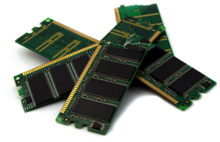
Memory Opt. Dataflow
Map
Reduce
Cached
Load
Training Data
(HDFS)
Map
Reduce
Map
Reduce
10-100× faster than network and disk

Slide 21
Memory Opt. Dataflow View
Map
Reduce
Efficiently move data
between stages
Training Data
(HDFS)
Map
Reduce
Map
Reduce

Slide 22
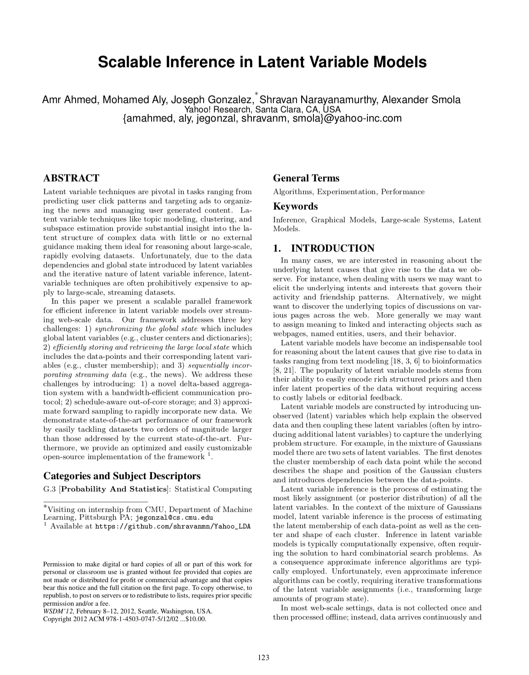
Statistical Inference in Large Latent Variable Models
Large topic models associated variables with each word and document
Not a good fit for BSP model
Word Dist. by Topic
Local Variables Documents
Tokens

Slide 23
Bulk Synchronous Parallel (BSP) Execution
Compute
Communicate
Compute
Machine 1
Iteration
Waste
Iteration
w
w¹
w
Machine 2
Iteration
Iteration
Waste
w
w²
w
Machine 3
Iteration
Waste
Iteration
w
w³
w
Barrier
Barrier

Slide 24
Asynchronous Execution
Compute
Communicate
Compute
Machine 1
Iteration
Waste
Iteration
Machine 2
Iteration
Iteration
Waste
Machine 3
Iteration
Waste
Iteration
Barrier
Barrier
Enable more frequent coordination on parameter values

Slide 25
Asynchronous Execution
Compute
Communicate
Compute
Machine 1
Iteration
Iteration
Machine 2
Iteration
Iteration
Machine 3
Iteration
Iteration
Enable more frequent coordination on parameter values

Slide 26
Asynchronous Execution
Parameter Server (Logical)
w₁
w₂
w₃
w₄
w₅
w₆
w₇
w₈
w₉
Machine 1
Iteration
Iteration
Iteration
Iteration
Machine 2
Iteration
Iteration
Iteration
Machine 3
Iteration
Iteration
Iteration
Iteration
Iteration

Slide 27
AlexNet

Slide 28
ImageNet Classification with Deep Convolutional Neural Networks
Alex Krizhevsky, Illya Sutskever, Geoffrey E. Hinton
TL;DR; This paper describe the deep convolutional architecture, training techniques, and system innovations that resulted in the winning entry for the ILSVRC-2012 Benchmark. This model substantially outperformed the next best model that year.

Slide 29
What is the problem being solved?
Image-Net Benchmark (ILSVRC-2012)
1.2M hand labeled (1000 classes) real-world images
Images have varying resolutions
Multiple tasks including
Classification – algorithm may return 5 predictions per image
Classification with Localization – Classification + a bounding box
Fine-Grained Classification; – 100+ dog subcategories.

Slide 30
The AlexNet* Architecture
Without GPU Partitioning
*Posthumously Named

Slide 31
The Actual AlexNet* Architecture
from the paper
*Posthumously Named

Slide 32
Training on Multiple GPUs
Limited by GPU memory using Nvidia GTX 580 (3GB RAM)
60M Parameters ~ 240 MB
Need to cache activation maps for backpropagation
Batch size = 128
128 * (227*227*3 + 55*55*96*2 + 96*27*27*2 + 256*27*27*2 + 256*13*13*2 + 13*13*384*2 + 256*13*13 + 6*6*256 + 4096 + 4096 + 1000) *4 Bytes ~ 782MB Activations
That is assuming no overhead and single precision values
Tuned splitting across GPUS to balance communication and computation
Image from https://neurohive.io/en/popular-networks/alexnet-imagenet-classification-with-deep-convolutional-neural-networks/

Slide 33
Interesting Consequence of Partitioned Training
Edge Detection
Color Filters

Slide 34
Put into historical context
AlexNet

Slide 35
Good Embeddings …
Embedding Layer
This will later be the foundation of many papers
Query
Images with largest dot product with query

Slide 36
DistBelief

Slide 37

Large Scale Distributed Deep Networks
NIPS 2012 (Same Year as AlexNet)
Described the system for the 2012 ICML Paper
Discovers Cat Features
Label
DistBelief

Slide 38
Building High-Level Features Using Large Scale Unsupervised Learning
ICML 2012
Pre-Convolutional* Architecture
9x “deep”
Each Neuron has separate weights
sparse connectivity
30x bigger than other deep nets.
~1 billion parameters!
*This pre-dates AlexNet but is two decades after LeNet.

Slide 39
Key Problems Addressed in DistBelief Paper
Main Problem
Speedup training for large models
Sub Problems
How to partition models and data
Variance in worker performance → Stragglers
Failures in workers → Fault-Tolerance

Slide 40
Large Scale Distributed Deep Networks
NIPS 2012 (Same Year as AlexNet)
Key Innovations in
Label
DistBelief

Slide 41
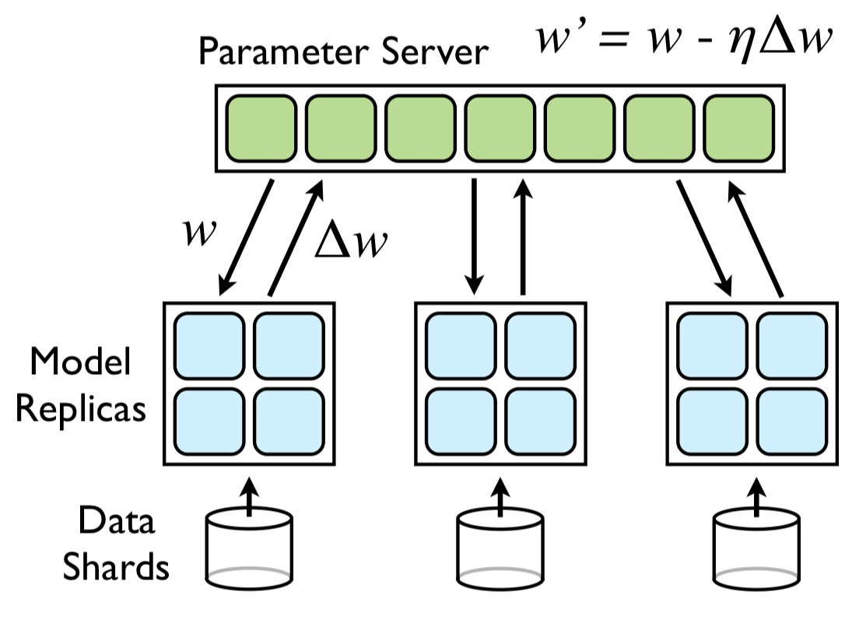
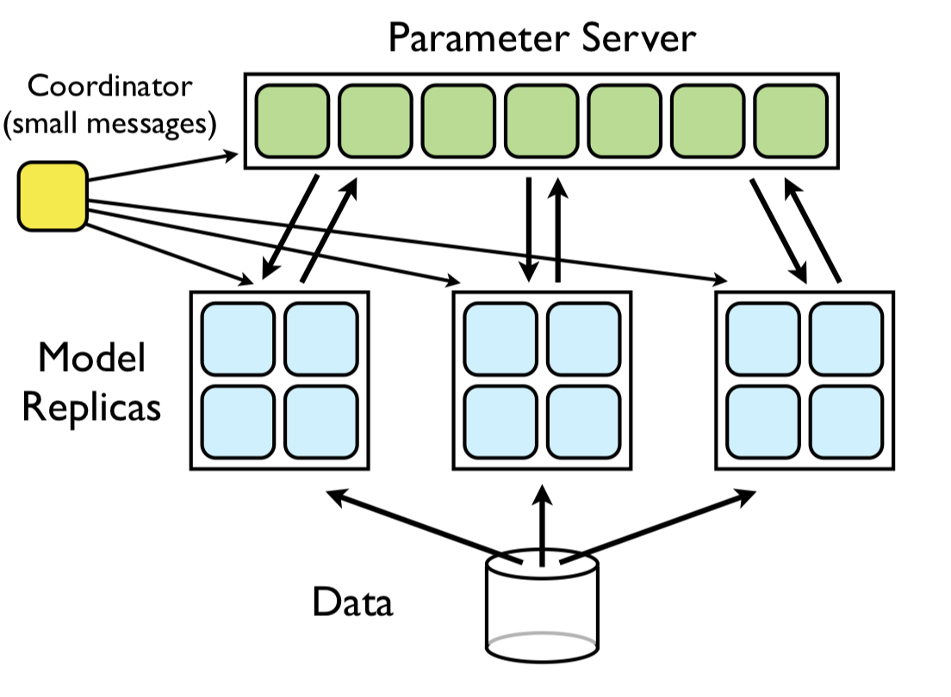
Combine Model and Data Parallelism
Model Parallelism
Data Parallelism
This appears in earlier work on graph systems …
Downpour SGD
Sandblaster L-BFGS

Slide 42
Combine Model and Data Parallelism
Model Parallelism
Data Parallelism
Asynchronous
Synchronous
Downpour SGD
Sandblaster L-BFGS

Slide 43
Sandblaster L-BFGS
Data Parallelism
Model Parallelism
L-BFGS
Commonly used for convex opt. problems
Requires repeated scans of all data
Robust, minimal tuning
Naturally fits map-reduce pattern
Innovations:
accumulate gradients and store outputs in a sharded key value store (parameter server)
Tiny tasks + backup tasks to mitigate stragglers
Synchronous
Asynchronous
Downpour SGD

Slide 44
Combine Model and Data Parallelism
Model Parallelism
Data Parallelism
Asynchronous
Synchronous
Downpour SGD
Sandblaster L-BFGS

Slide 45
Downpour SGD
Data Parallelism
Model Parallelism
Claimed Innovations
Parameter Server
Combine model and data parallelism in an async. execution.
Adagrad stabilization
Warmstarting
Asynchronous
Synchronous
Sandblaster L-BFGS

Slide 46
Parameter Servers
Essentially a sharded key-value store
support for put, get, add
Idea appears in earlier papers:
“An Architecture for Parallel Topic Models”, Smola and Narayanamruthy. (VLDB’10)
“Scalable Inference in Latent Variable Models”, Ahmed, Aly, Gonzalez, Narayanamruthy, and Smola. (WSDM’12)
Asynchronous
DistBelief was probably the first paper to call a sharded key-value store a Parameter Server.

Slide 47
Downpour SGD
Data Parallelism
Model Parallelism
Claimed Innovations
Parameter Server
Combine model and data parallelism in an async. execution.
Adagrad stabilization
Warmstarting
Asynchronous
Synchronous
Sandblaster L-BFGS

Slide 48
Key Results: Training and Test Error
Weird 20K Error Metric
Looks like learning rate reset
Wall clock time is good.

Slide 49
Why are they in the NY Times
Trained a 1.7 billion parameter model (30x larger than state-of-the-art) (was it necessary?)
Using 16,000 cores (efficiently?)
Achieves 15.8 accuracy on ImageNet 20K (70% improvement over state of the art).
Non-standard benchmark
Qualitatively interesting results

Slide 50
Long-term Impact
The parameter server appears in many later machine learning systems
Downpour (Asynchronous) SGD has been largely replaced by synchronous systems for supervised training
Asynchrony is still popular in RL research
Why?
Model parallelism is still used for large language models
Predated this work
The neural network architectures studied here have been largely replaced by convolutional networks

Slide 51
More recent large-scale training
2018 (Unpublished on Arxiv)
NIPS 2012 (Same Year as AlexNet)
Generated a lot of press
Surpassed by
Fast.ai: “Now anyone can train ImageNet in 18 minutes for $40.” blog post
Popularized linear learning rate scaling

Slide 52
Contrasting to the first paper
Synchronous SGD
Much of the recent work has focused on synchronous setting
Easier to reason about
Focus exclusively on data parallelism: batch-size scaling
Focuses on the generalization gap problem

Slide 53
How do you distribute SGD?
initial vector (random, zeros …)
For t from 0 to convergence:
Stochastic Gradient Descent
Slow? (~150ms) Depending on size of B
Data Parallelism

Slide 54
Batch Size Scaling
Increase the batch size by adding machines
Each server processes a fixed batch size (e.g., n=32)
As more servers are added (k) the effective overall batch size increases linearly
Why do these additional servers help?

Slide 55
Bigger isn’t Always Better
Motivation for larger batch sizes
More opportunities for parallelism → but is it useful?
Recall (1/n variance reduction):
Is a variance reduction helpful?
Only if it let’s you take bigger steps (move faster)
Does it affect the final prediction accuracy?

Slide 56
Generalization Gap Problem
Larger batch sizes harm generalization performance.

Slide 57
Rough “Intuition”
Small batch gradient descent acts as a regularizer
Loss
Sharp Minima Hypothesis
Parameter values along some direction
Key problem: Addressing the generalization gap for large batch sizes.

Slide 58
Solution: Linear Scaling Rule
Scale the learning rate linearly with the batch size
Addresses generalization performance by taking larger steps (also improves training convergence)
Sub-problem: Large learning rates can be destabilizing in the beginning. Why?
Gradual warmup solution: increase learning rate scaling from constant to linear in first few epochs
Doesn’t help for very large k…

Slide 59
Other Details
Independent Batch Norm: Batch norm calculation applies only to local batch size (n).
All-Reduce: Recursive halving and doubling algorithm
Used instead of popular ring reduction (fewer rounds)
Gloo a library for efficient collective communications
Big Basin GPU Servers: Designed for deep learning workloads
Analysis of communication requirements → latency bound
No discussion on straggler or fault-tolerance
Why?!

Slide 60
Key Results
Training vs Validation
All curves closely match using the linear scaling rule.
Note learning rate schedule drops.

Slide 61
Key Results
“Learning” Epoch
Epoch
Second
Machine Learning
System

Slide 62
Key Results
Train ResNet-50 to state-of-the-art on 256 GPUs in 1 hour
90% scaling efficiency
Fairly careful study of the linear scaling rule
Observed limits to linear scaling do not depend on dataset size
Cannot scale parallelism with dataset size

Slide 63
All-Reduce

Slide 64
All Reduce
Mechanism to sum and distribute data across machines.
Used to sum and distribute the gradient
Machine A
Machine B
a₁
a₂
a₃
a₄
b₁
b₂
b₃
b₄
Machine D
Machine C
d₁
d₂
d₃
d₄
c₁
c₂
c₃
c₄

Slide 65
All Reduce
Mechanism to sum and distribute data across machines.
Used to sum and distribute the gradient
Machine B
b₁
b₂
b₃
b₄
Single Master All-Reduce
Machine A
a₁
a₂
a₃
a₄
Machine D
Machine C
d₁
d₂
d₃
d₄
c₁
c₂
c₃
c₄

Slide 66
All Reduce
Mechanism to sum and distribute data across machines.
Used to sum and distribute the gradient
Machine B
Single Master All-Reduce
Machine A
Sends (P-1) * N Data
P Machines
N Parameters
a₁
a₂
a₃
a₄
b₁
b₂
b₃
b₄
c₁
c₂
c₃
c₄
d₁
d₂
d₃
d₄
Machine D
Machine C

Slide 67
All Reduce
Mechanism to sum and distribute data across machines.
Used to sum and distribute the gradient
Machine B
Single Master All-Reduce
Machine A
Sends (P-1) * N Data
P Machines
N Parameters
a₁
a₂
a₃
a₄
b₁
b₂
b₃
b₄
c₁
c₂
c₃
c₄
d₁
d₂
d₃
d₄
s_{i}
=
a_{i}
+
b_{i}
+
c_{i}
+
d_{i}
Machine D
Machine C

Slide 68
All Reduce
Mechanism to sum and distribute data across machines.
Used to sum and distribute the gradient
Machine B
Single Master All-Reduce
Machine A
Sends (P-1) * N Data
P Machines
N Parameters
s₁
s₁
s₁
s₁
s₂
s₂
s₂
s₂
s₃
s₃
s₃
s₃
s₄
s₄
s₄
s₄
s_{i}
=
a_{i}
+
b_{i}
+
c_{i}
+
d_{i}
Machine D
Machine C

Slide 69
All Reduce
Mechanism to sum and distribute data across machines.
Used to sum and distribute the gradient
Machine B
Single Master All-Reduce
s₁
s₂
s₃
s₄
*2
Machine A
Sends (P-1) * N Data
P Machines
N Parameters
s₁
s₂
s₃
s₄
s_{i}
=
a_{i}
+
b_{i}
+
c_{i}
+
d_{i}
Machine D
Machine C
s₁
s₂
s₃
s₄
s₁
s₂
s₃
s₄

Slide 70
All Reduce
Mechanism to sum and distribute data across machines.
Used to sum and distribute the gradient
*2
Single Master All-Reduce
Sends (P-1) * N Data
P Machines
N Parameters
Machine A
Machine D
Machine C
Machine B
Issues?
High fan-in on Machine A
(P-1) * N Bandwidth for Machine A

Slide 71
All Reduce
Mechanism to sum and distribute data across machines.
Used to sum and distribute the gradient
Machine A
Machine B
a₁
a₂
a₃
a₄
b₁
b₂
b₃
b₄
Parameter Server All Reduce
Machine D
Machine C
d₁
d₂
d₃
d₄
c₁
c₂
c₃
c₄

Slide 72
All Reduce
Mechanism to sum and distribute data across machines.
Used to sum and distribute the gradient
Machine A
Machine B
a₁
a₂
a₃
a₄
b₁
b₂
b₃
b₄
Send each entry to parameter server for that entry.
Key 1 → A
Key 2 → B
Key 3 → C
Key 4 → D
Machine D
Machine C
d₁
d₂
d₃
d₄
c₁
c₂
c₃
c₄

Slide 73
Machine A
Machine B
a₁
b₁
c₁
d₁
a₂
b₂
c₂
d₂
Each machine sends N/P data to all other machines.
P * (P-1) * N/P = (P-1) * N
P Machines
N Parameters
Machine D
Machine C
a₄
b₄
c₄
d₄
a₃
b₃
c₃
d₃

Slide 74
Machine A
Machine B
s₁
s₂
Compute local sum on each machine
s_{i}
=
a_{i}
+
b_{i}
+
c_{i}
+
d_{i}
Machine D
Machine C
s₄
s₃

Slide 75
Machine A
Machine B
s₁
s₁
s₁
s₂
s₂
s₂
s₁
s₂
Broadcast sum to each machine
Machine D
Machine C
s₄
s₄
s₄
s₄
s₃
s₃
s₃
s₃

Slide 76
Machine A
Machine B
s₁
s₂
s₃
s₄
s₁
s₂
s₃
s₄
Broadcast sum to each machine
Machine D
Machine C
s₁
s₂
s₃
s₄
s₁
s₂
s₃
s₄

Slide 77
Parameter Server All-Reduce
Same amount of data transmitted as before
Same high fan-in (P-1)
Reduced Inbound Bandwidth = (P-1)N/P
Previously (P-1)*N
Machine A
Machine B
Machine D
Machine C

Slide 78
Machine A
Machine B
a₁
a₂
a₃
a₄
b₁
b₂
b₃
b₄
Ring All Reduce
Send messages in a ring using to reduce fan-in.
Machine D
Machine C
d₁
d₂
d₃
d₄
c₁
c₂
c₃
c₄

Slide 79
Machine A
Machine B
a₂
a₃
a₄
b₁
b₃
b₄
d₄
a₁
← Note this depicts a partial sum and not a bigger message.
Ring All Reduce
Machine D
Machine C
d₁
d₂
d₃
c₁
c₂
c₄
c₃
b₂

Slide 80
Machine A
Machine B
a₂
a₃
b₃
b₄
d₃
a₄
c₃
d₄
Ring All Reduce
Machine D
Machine C
d₁
d₂
c₁
c₄
c₂
b₁
b₂
a₁

Slide 81
Machine A
Machine B
a₂
b₃
d₂
a₃
c₂
d₃
b₂
c₃
Ring All Reduce
Machine D
Machine C
d₁
c₄
c₁
b₄
b₁
a₄
a₁
d₄

Slide 82
Machine A
Machine B
s₃
s₃
s₃
s₂
s₃
s₂
s₂
s₂
Ring All Reduce
Each machine sends N/P data to next machine each of (p-1) rounds:
(P-1) * P * N/P = (P-1) * N
Bandwidth per round:
P (N/P) = N (doesn’t depend on P)
Fan-in Per Round:
1 (doesn’t depend on P)
Machine D
Machine C
s₁
s₁
s₁
s₁
s₄
s₄
s₄
s₄

Slide 83
Machine A
Machine B
s₃
s₃
s₃
s₂
s₃
s₂
s₂
s₂
Ring All Reduce
Broadcast stage repeats process sending messages forwarding sums (same communication costs).
Machine D
Machine C
s₁
s₁
s₁
s₁
s₄
s₄
s₄
s₄

Slide 84
Machine A
Machine B
s₂
s₂
s₁
s₂
s₃
s₁
s₁
s₂
Ring All Reduce
Machine D
Machine C
s₁
s₄
s₄
s₄
s₃
s₄
s₃
s₃

Slide 85
Machine A
Machine B
s₁
s₁
s₂
s₃
s₂
s₄
s₁
s₄
Ring All Reduce
Machine D
Machine C
s₁
s₃
s₄
s₄
s₃
s₂
s₃
s₂

Slide 86
Machine A
Machine B
s₁
s₂
s₃
s₄
s₁
s₂
s₃
s₄
Ring All Reduce
Machine D
Machine C
s₁
s₂
s₃
s₄
s₁
s₂
s₃
s₄

Slide 87
Machine A
Machine B
s₁
s₂
s₃
s₄
s₁
s₂
s₃
s₄
Ring All Reduce
Machine D
Machine C
s₁
s₂
s₃
s₄
s₁
s₂
s₃
s₄

Slide 88
Ring All-Reduce
Simplified communication topology with low fan-in
Overall communication
Same total communication: 2*(P-1)*N
Bandwidth per round (N) doesn’t depend on P
Fan-in is constant (doesn’t depend on P)
Issue: Number of communication rounds (P-1)
Machine A
Machine B
Machine D
Machine C

Slide 89
Double Binary Tree All-Reduce
Two overlaid binary reduction trees
Double the fan-in → Log(p) rounds of communication
Currently used on Summit super-computer and latest NCCL
https://devblogs.nvidia.com/massively-scale-deep-learning-training-nccl-2-4/

Slide 90
Dimensions of Parallelism
Review:

Slide 91
Data Parallelism
Parallelizing mini-batch gradient calculation with model replicated to all machines.
Synchronous Execution (Most Common)
Strengths: deterministic, parallelism does not effect result
Weaknesses: need large batch sizes, frequent blocking comm., learning rate scaling, doesn’t work with batch normalization
Asynchronous Execution (Popular in Research)
Strengths: eliminate blocking and use background comm., batches don’t need to span machines
Weaknesses: affects convergence (stability)
Issues:
Model and activations must fit in each machine

Slide 92
Model Parallelism
Divide the model across machines and replicate the data.
Supports large models and activations
Requires communication within single evaluation
How to best divide a model?
Split individual layers
which dimension?
Batch or Spatial → depends on operation
Split across layers
Only one set of layers active a time → poor work balance
Soln: Pipelining Parallelism

Slide 93
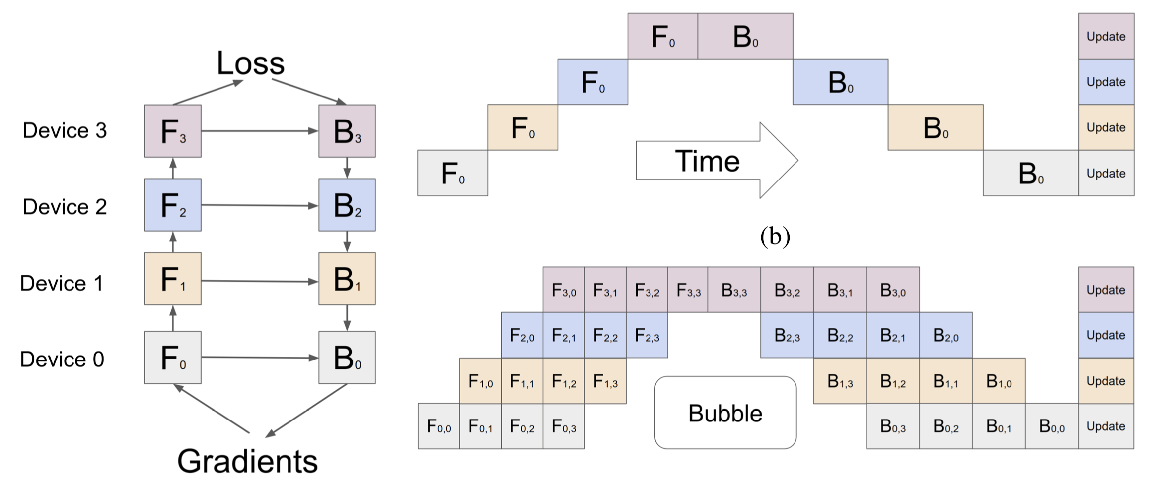
Pipeline Parallelism
Combine model and data parallelism to concurrently process multiple layers and batches.
Originally described in GPipe*
*GPipe: Easy Scaling with Micro-Batch Pipeline Parallelism

Slide 94
Operator Level Parallelism
Exploiting the parallelism within linear algebra and convolution operations (a form of model parallelism)
Multiple dimensions
Batch, spatial, time, …
Typically cast operators as linear alg. routines and leverage optimizes BLAS libraries
im2col convolution

Slide 95
This weeks readings

Slide 96
Reading for the Week
Scaling Distributed Machine Learning with the Parameter Server (OSDI’14)
Paper describing the parameter server system
PipeDream: Generalized Pipeline Parallelism for DNN Training (SOSP’19)
Latest paper exploring pipeline parallel training
Adaptive Communication Strategies to Achieve the Best Error-Runtime Trade-off in Local-Update SGD (SysML’19)
Dynamic averaging approach to distributed training

Slide 97
Scaling Distributed Machine Learning with the Parameter Server (OSDI’14)
Describes the key-value store customized for machine learning
Builds on earlier work in parameter servers
Additional Context: focused on topic modeling and sparse regression
Key Ideas: There are many ideas …
Keys – Value pairs with linear algebra semantics (e.g., get by range)
User defined event handlers on parameter servers and workers
Several different consistency models
User defined filters to determine when updates are communicated

Slide 98
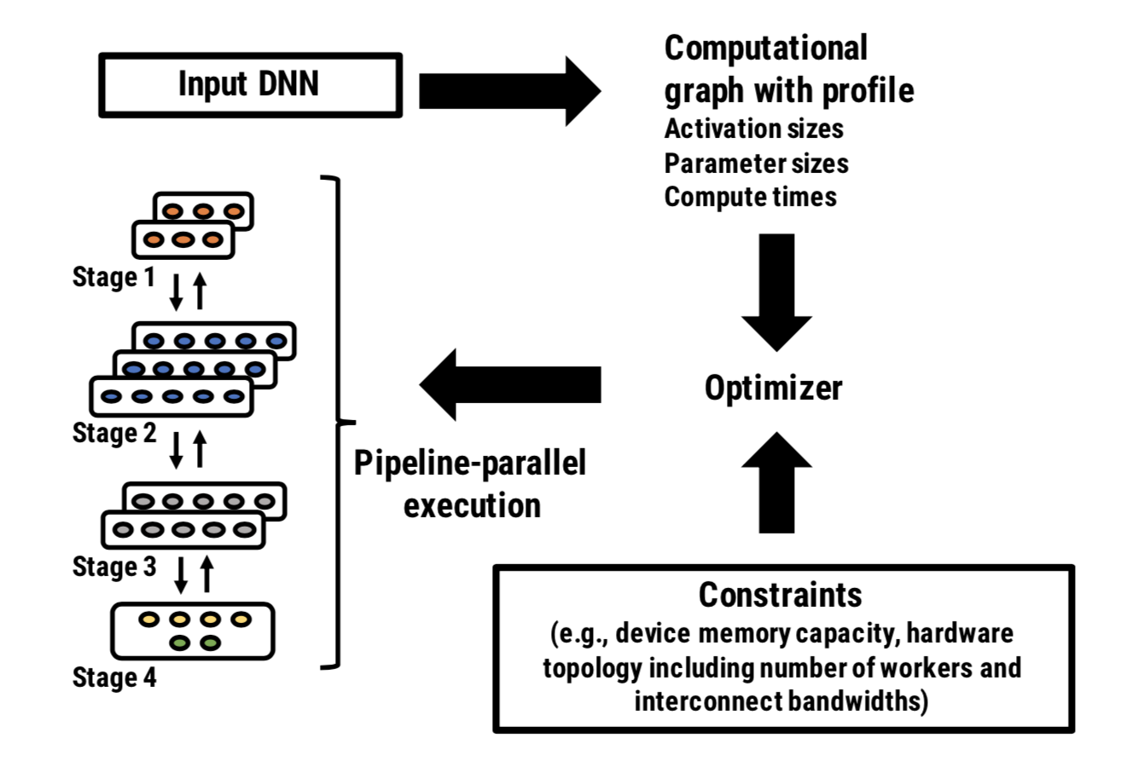
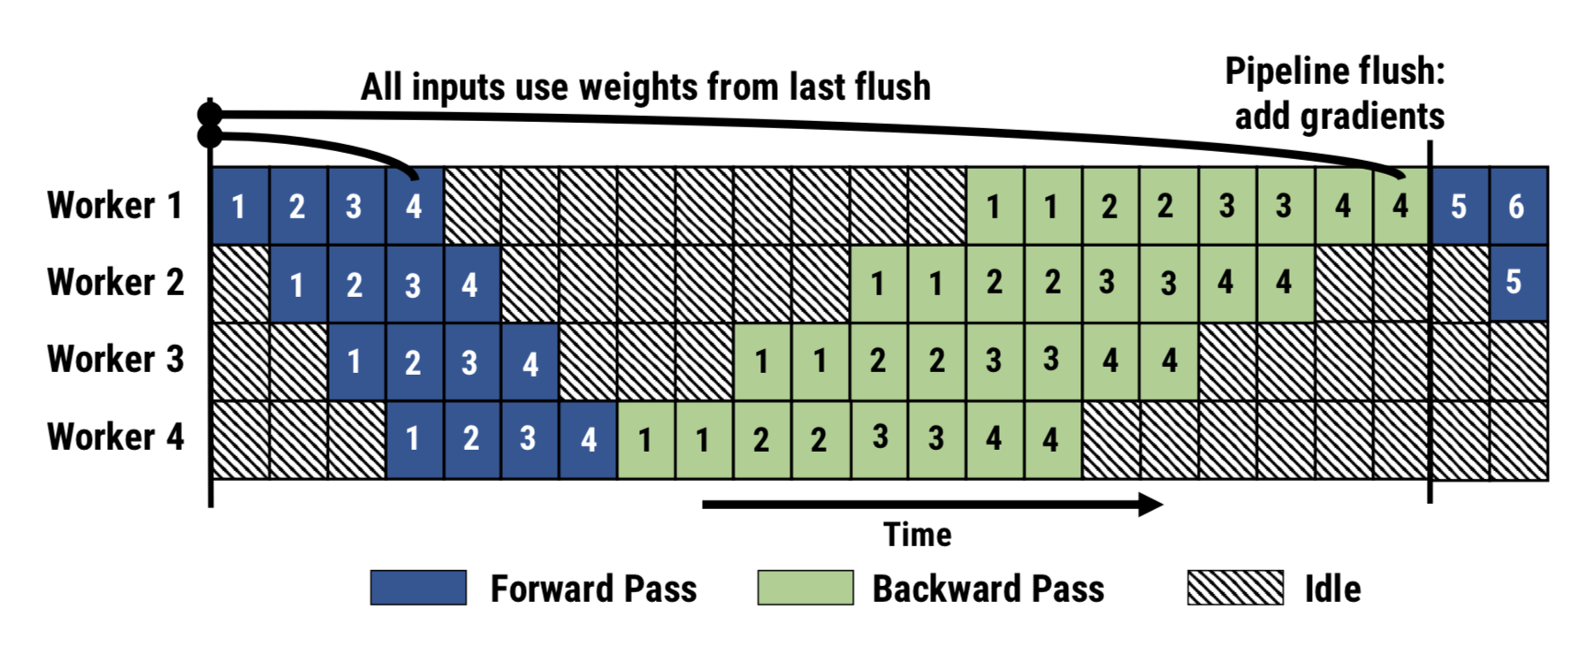
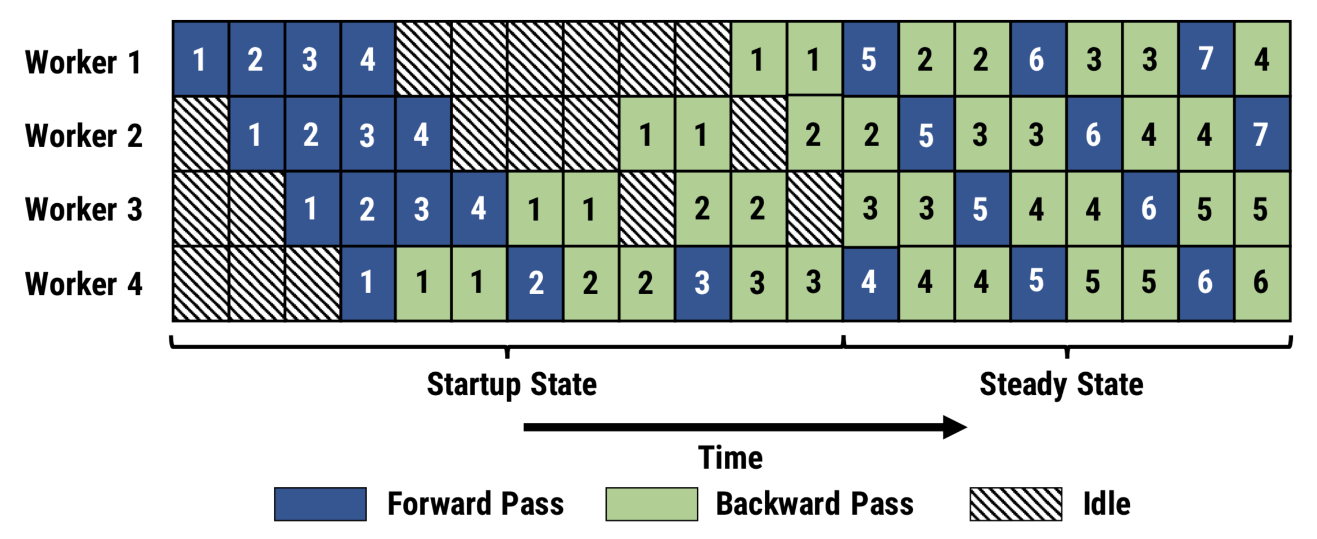
PipeDream: Generalized Pipeline Parallelism for DNN Training (SOSP’19)
Contemporaneously published with:
GPipe: Efficient Training of Giant Neural Networks using Pipeline Parallelism (arXiv’18)
Key idea: Leverage pipeline parallelism during training
Automatically constructs pipeline partition + schedule
Leverage bounded staleness + versioned activations to eliminate bubbles
PipeDream
GPipe

Slide 99
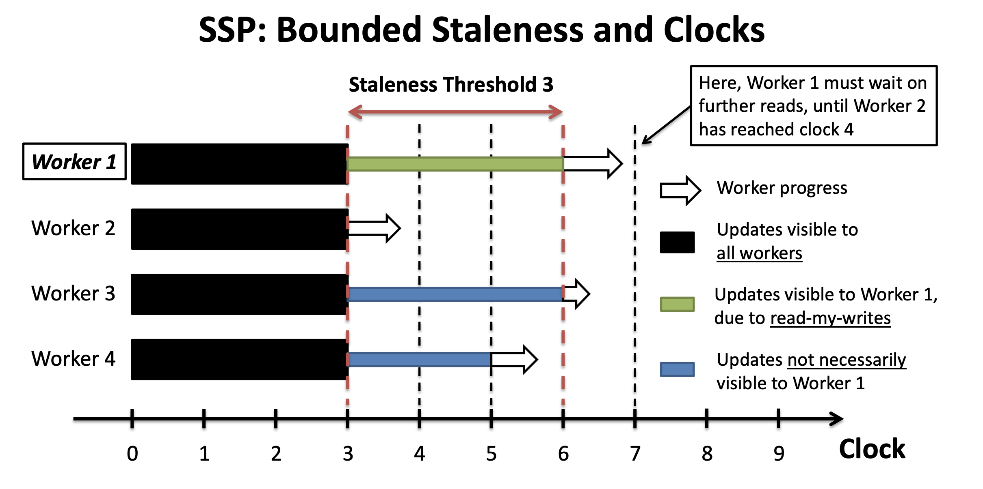
Bounded Staleness
Developed as part of the parameter server work at CMU
More Effective Distributed ML via a Stale Synchronous Parallel Parameter Server (NIPS’13)
Compromise between Hogwild and BSP
Unclear implications for deep learning
Non-convex loss

Slide 100
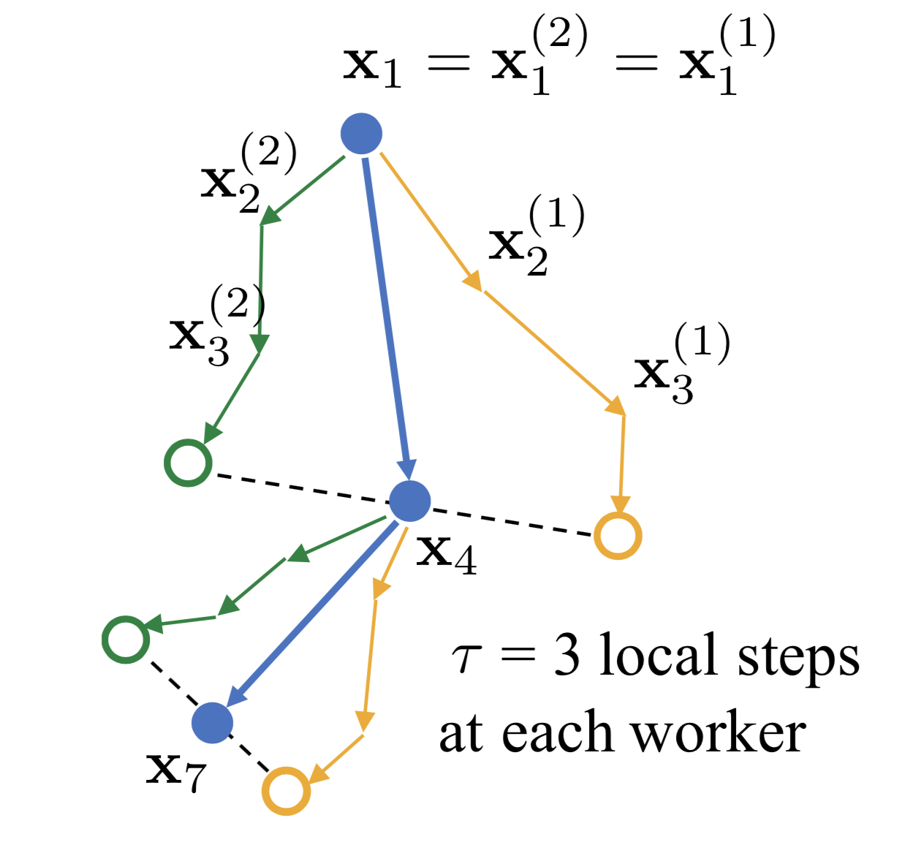
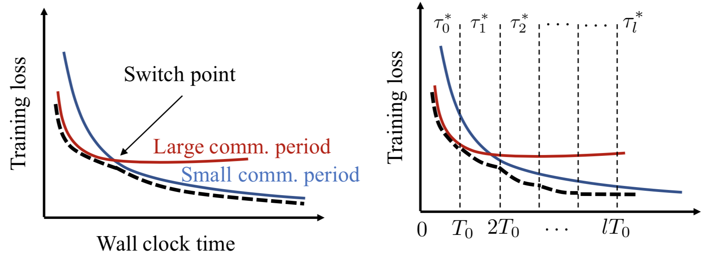
Adaptive Communication Strategies to Achieve the Best Error-Runtime Trade-off in Local-Update SGD (SysML’19)
Studies Periodic Averaging SGD (PASGD)
Key Idea: Change 𝜏 as algorithm converges
More theoretical than previous reading
Theoretical results do not make convex assumptions!
Notes:
Parallelized Stochastic Gradient Descent (NIPS’10)
Parallel training of DNNs with Natural Gradient and Parameter Averaging (ICLR’15)
Deep learning with Elastic Averaging SGD (NIPS’15)
SparkNet: Training Deep Networks in Spark (ICLR’16)

Slide 101
Old Stuff

